Slide 1

PROJECT - 2
Salaries for San Francisco Employee
Problem Statement: This Project aims to clarify the complexities of the employee compensation in San Francisco, including base salary, overtime, and benefits. By identifying trends and pay structures across roles, it supports informed city planning and budget decisions.
by MANKAR KRISHNA TANMAYEE
MT

Slide 2

Objective: Comprehensive Salary Data Analysis
Discover Trends
Trace salary changes across years and departments.
Identify Key Roles
Highlight top-paying and most frequent jobs.
Analyze Correlations
Understand factors impacting salaries.
Predict Salaries
Build models for equitable pay adjustments.

Slide 3
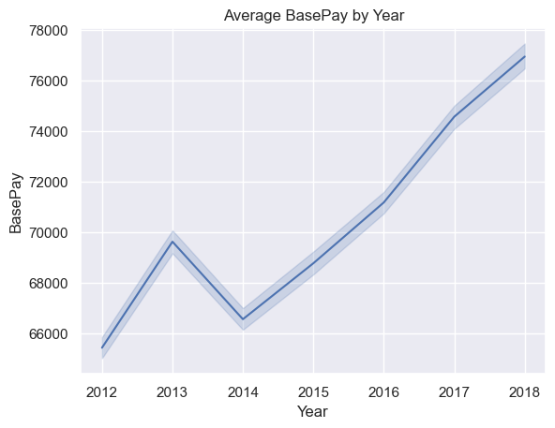
Salary Trends by Year (2014-2018)
Increasing Salaries
Key Drivers
Average salary rose steadily from 2014 to 2018.
Inflation and city budget growth likely influenced rises.
Policy Impact
Salary adjustments align with city workforce plans.

Slide 4
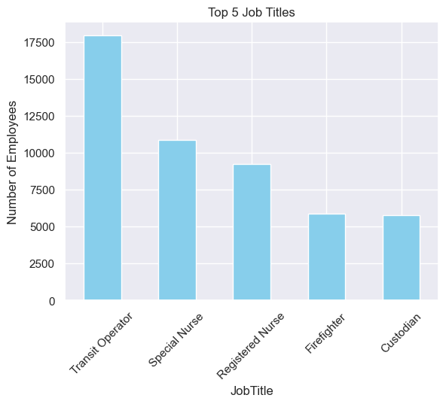
Top 5 Job Titles by Frequency
Transit Operator
Special Nurse
Registered Nurse
Highest number of
employees in this role.
Second highest number of employees in this role.
Large health sector presence
in city jobs.
Firefighter
Custodian
Supports various city departments effectively.
Maintains cleanliness across
city facilities.

Slide 5
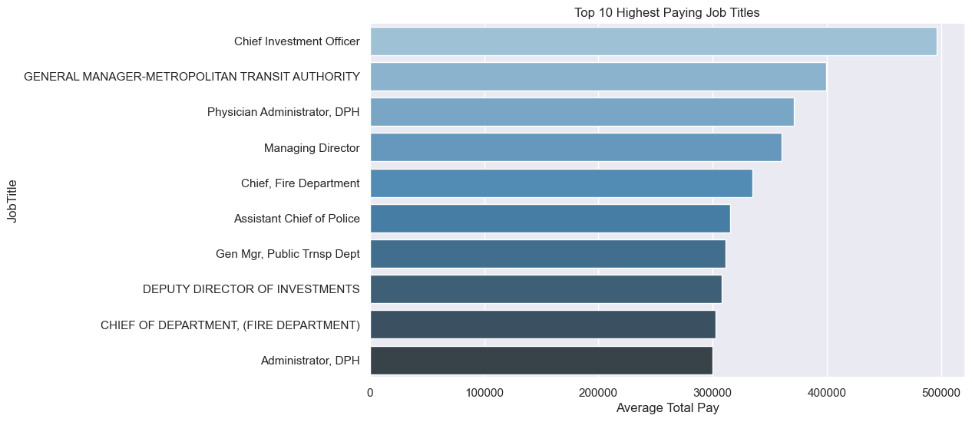
Top 10 Highest Paying Job Titles
Chief Investment Officer
General Manager
Physician Administrator, DPH
Managing Director
Chief, Fire Department
Assistant Chief of Police
Gen Mgr, Public Trnsp Dept
Deputy Director of Investments
Chief of Fire Department
Administrator, DPH

Slide 6
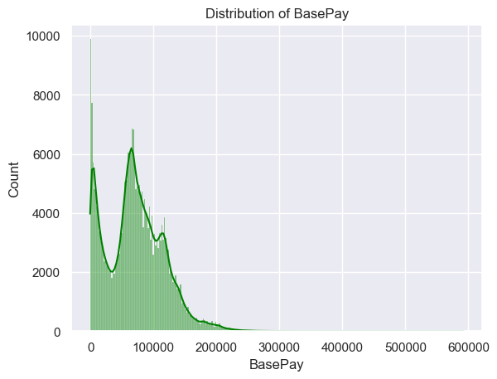
Salary Distribution
Median Salary
Central value indicating typical employee pay.
Salary Range
Skewness
Wide range from low to high salaries.
Distribution skewed toward higher salaries.

Slide 7
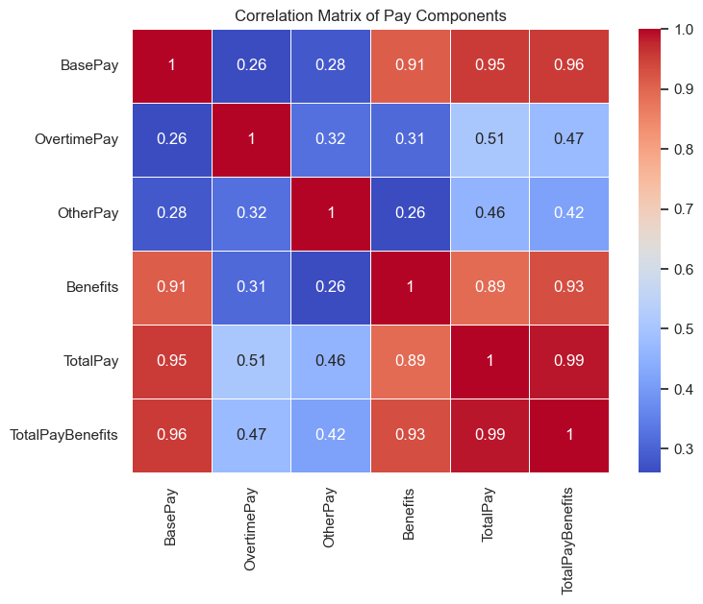
Correlation Heatmap: Factors Influencing Salary
Positive Correlations
Strong positive correlations between TotalPay and TotalPayBenefits.
Negative Correlations
Lower correlations with OvertimePay and BasePay.

Slide 8
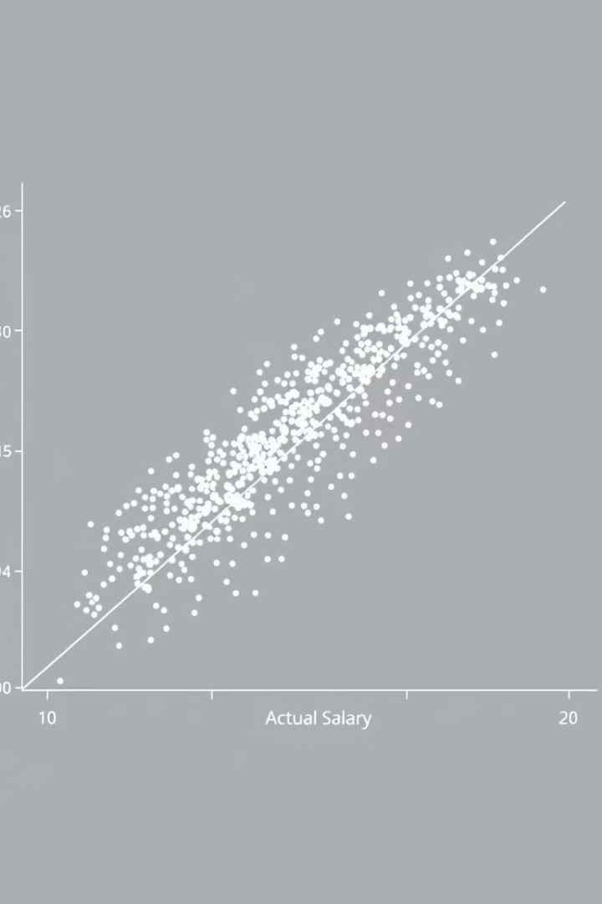
Linear Regression Model: Salary Prediction
Model Inputs
Model Accuracy
TotalPayBenefits, BasePay, and
OverTimePay used.
R-squared of 1.0 indicating perfect fit.
Performance Metrics
MAE shows minimal average prediction error.

Slide 9

Insights and Recommendations
Salary Growth Strong
Steady increase from 2014 to 2018 observed.
Frequent Roles
Transit Operators and Nurses dominate workforce.
Model Confirmation
Predictive model supports data-backed pay adjustments.
Structural Refinement
Adjust salaries based on experience and performance.

Slide 10

Conclusion
Data helps us understand how salaries are changing—and where people may be
facing unfair gaps or disparities.
Helps ensure everyone is paid fairly and equitably for the work they do.
Boosts team spirit and shows people they can trust your company.
Keeping an eye on things regularly helps ensure everyone is treated—and
paid—fairly.

Slide 11


